Slide 1

W
A
S
D
move
E
Use special skill
Q
ulti
Normal attack
M
Quickly open the menu and pause the game
Esc
Quit menu
1
2
3
4
Switch between characters

Slide 2




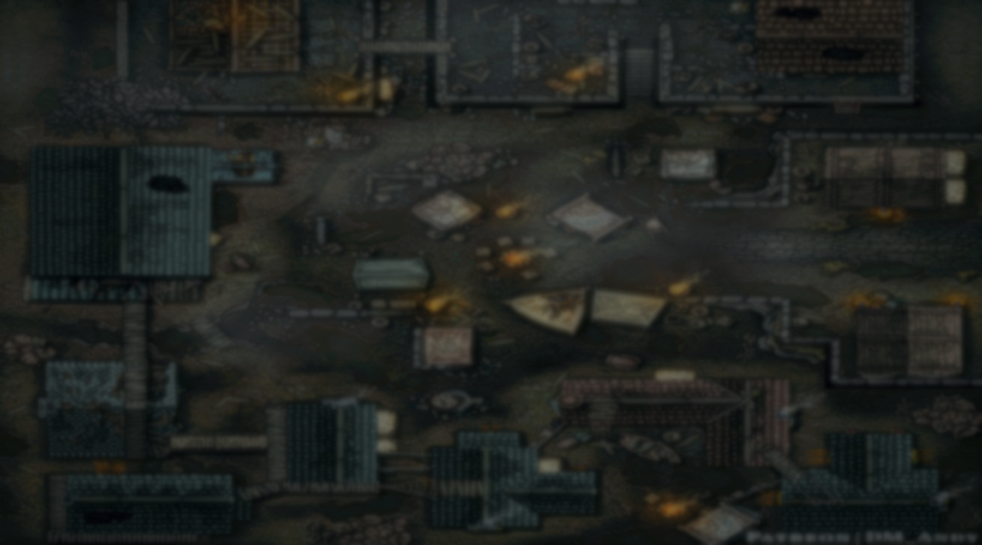


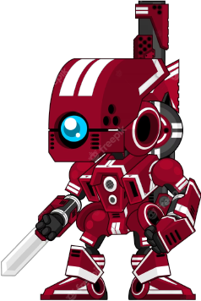
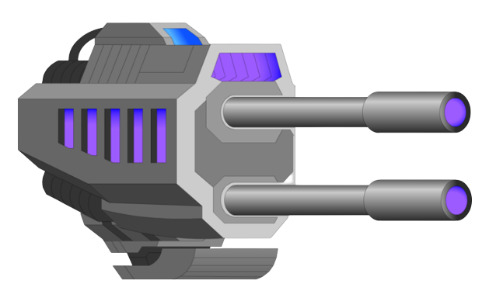
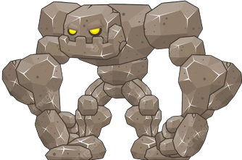
MAP 1 – Prehistoric Times
You are lost in prehistoric times and attacked by terrifying dinosaurs. Your mission is to survive within the allotted time by moving, dodging and attacking them
MAP 2 – Machine War
In the future world, the excessive development of technology has caused robots to lose control and attack humans. You are tasked with handling those robots and machines to earn yourself enough points to pass the next level.
MAP 3 – Final Boss
Monsters are always dangerous and need to be destroyed. Your entire character will be revived. Go ahead, defeat the final boss to win, and beware of deadly rocks !

Slide 3
This is a monster shooting game to survive. You can control your character and attack.
- You are provided with 4 different characters, the character that dies will no longer be able to use
- You have to clear 3 maps to win
- On each map, you can move to gain experience and support skills to increase your strength

Slide 4




Normal attack
Fires a wind bullet in the direction of the mouse click and deals 100 damage
Elemental Skill
Summons an orb of wind that shoots in the direction the mouse clicks and deals 150 damage
Ultimate
Uses wind magic to summon a tornado along the character's direction and deal 200 damage, piercing all enemies in the path.

Slide 5



Normal attack
Fires a blue lightning bolt in the direction the mouse clicks and deals 100 damage
Elemental Skill
Place a timer bomb at the location of the mouse click, after 1.5 seconds the bomb will explode and deal 200 damage in a wide area around
Ultimate
Lightning strikes continuously at the mouse click and deals 150 continuous damage to enemies in range, lasting for 7 seconds.

Slide 6



Normal attack
Fires an orb of water in the direction the mouse clicks and deals 100 damage
Elemental Skill
Use the power of water to create a shield that lasts for 10 seconds. Shield will block all damage from all sources and make the character in the squad (including switching to another character) invulnerable for the duration
Ultimate
Fires 9 water swords forward, piercing through all enemies in the path and dealing 150 damage each

Slide 7
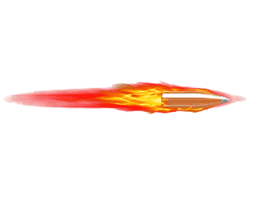



Normal attack
Shoot bullets at the mouse click and deal 100 damage
Elemental Skill
Shoots a fireball at the mouse click and deals 200 damage
Ultimate
Enhances the flame to blue, shoots through all enemies and deals 300 damage

Slide 8





Slide 9






OK
OK
Only 0.99$ 1.00 to get Premium 👑

Slide 10


Slide 11


Slide 12




1
1
2
2
3
3
4
4

